Slide 1
San Francisco Data Analysis
By
Karthikeya Challa

Slide 2
Project Statement
Aim is to provide the neighborhood data of a city to a new immigrant
In this project the following information is provided:
a) Best neighborhoods to settle
b) Best neighborhoods to setup a restaurant business

Slide 3
Data Section: KDNuggets
A lot of data is available on crime rates in SF city
https://data.sfgov.org/Public-Safety/Police-Department-Incident-Reports-2018-to-Present/wg3w-h783
Also to choose a neighborhood to settle a good school district is essential. The school and college information for the SF city is available at KDNuggets
https://data.sfgov.org/Economy-and-Community/Colleges-in-San-Francisco-2011-/8r3f-pc6a

Slide 4
Data Section: FourSquare API
FourSquare API is a location based service provider
It helps in getting the venues details in a given location
https://developer.foursquare.com/

Slide 5
Python Packages
Pandas: Dataframe creation and manipulation
Numpy: Mathematical Analysis
Matplotlib: Python plotting module
Folium: Interactive leaflet map creation
Scikit Learn: Implementing k-means clustering algorithm
JSON: Handling JSON files
Geocoder: Retrieving location data

Slide 6
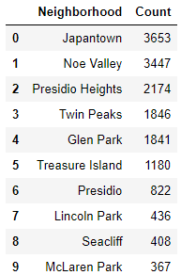
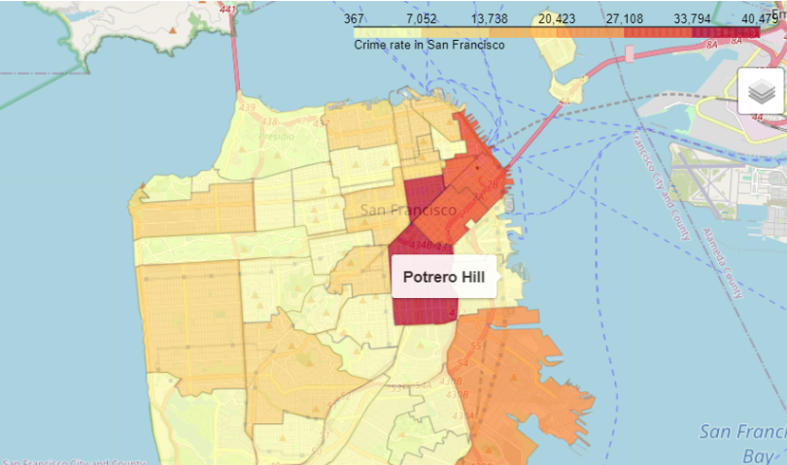
Crime Data Analysis
The crime data from the data section is obtained and the top 10 neighborhoods with least crimes are listed, along with a map visualization

Slide 7
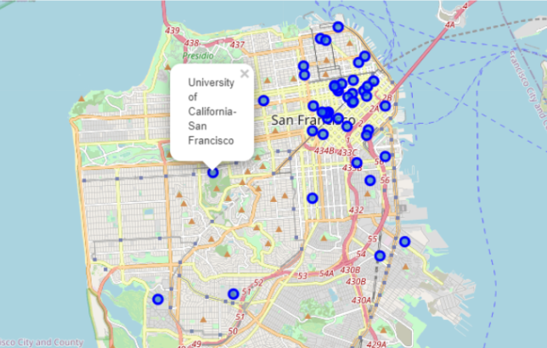
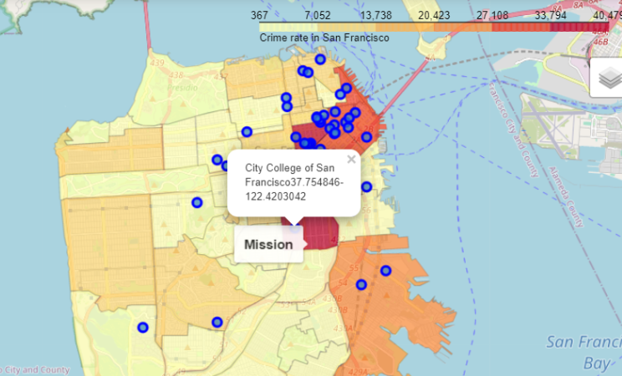
College Data Analysis
The college data is obtained and map visualization are provided after segregating per neighborhood

Slide 8
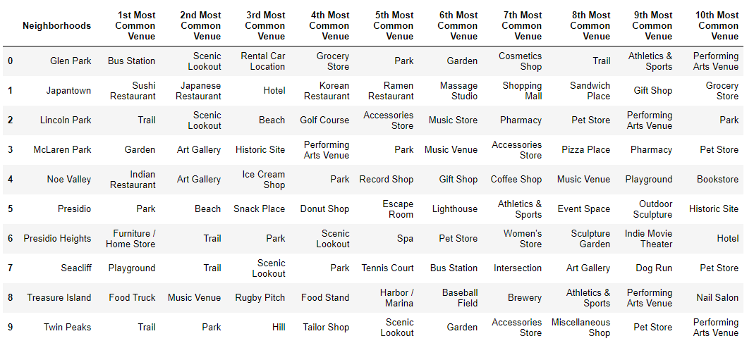
Top 10 common venues for top 10 neighborhoods with low crimes

Slide 9
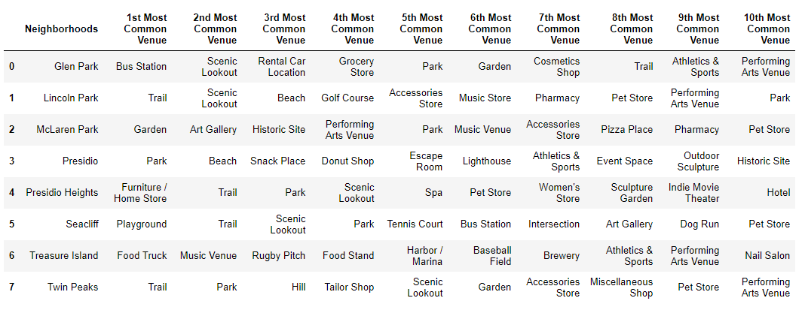
Top Neighborhoods to setup restaurant business

Slide 10

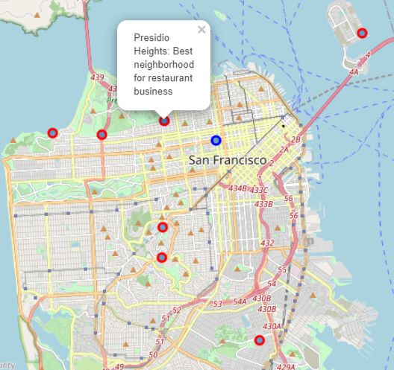
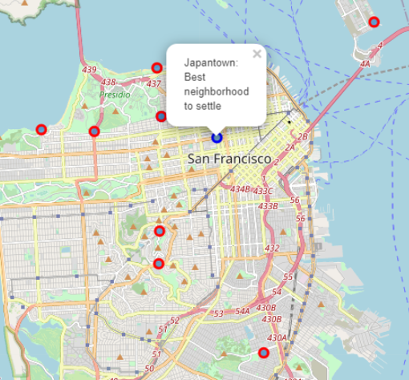
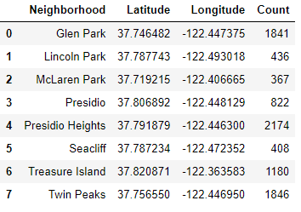
Best neighborhoods to settle and start restaurant business

Slide 11
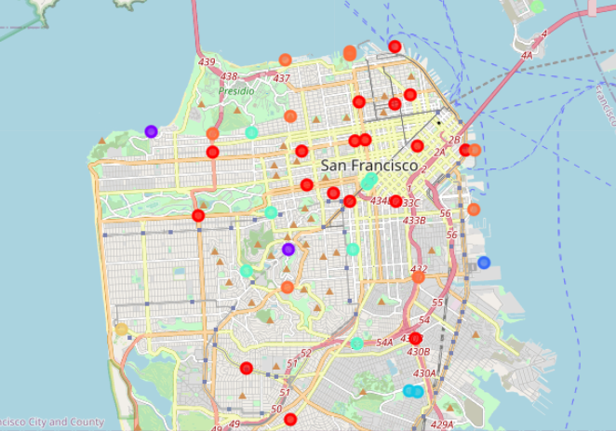
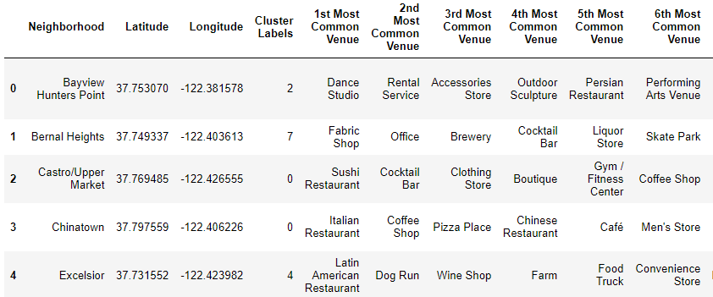
K-Means clustering:
The similarities or dissimilarities between two neighborhoods in a city could be visualized by segmenting them into various clusters utilizing the k-means clustering machine learning algorithm. So, this project aims at clustering and making sense of data obtained from this clustering technique

Slide 12
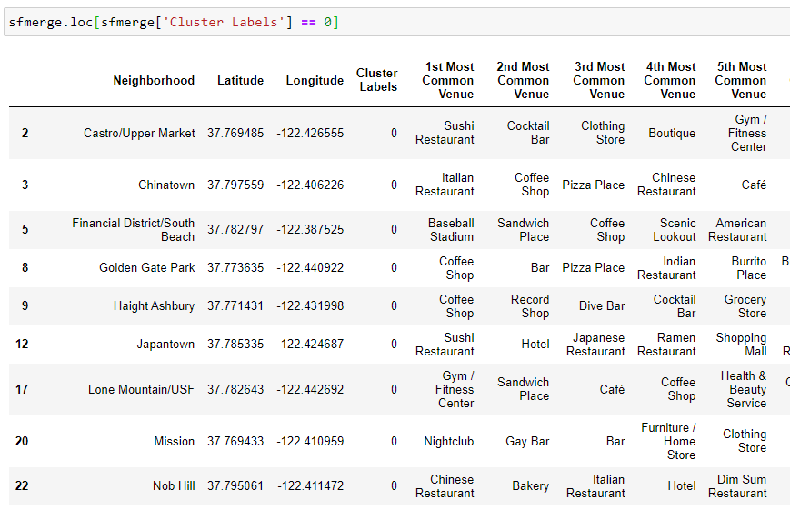
Proof From KMeans Clustering
The Data Frame for the cluster 0 consists of neighborhoods with restaurants in their most common venues
None of the neighborhoods to setup a restaurant business are in this cluster

Slide 13
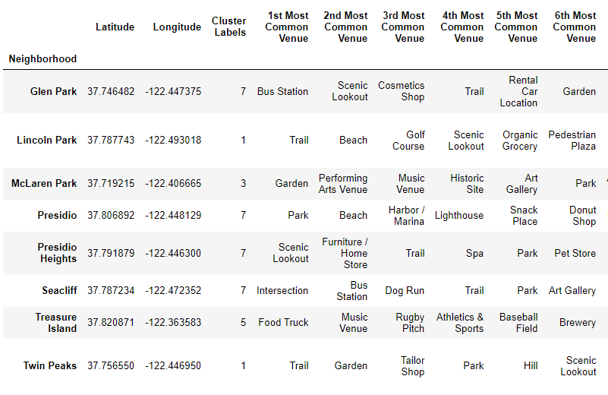
Other Clusters

Slide 14
Drawbacks and Conclusion
For settlement decision, more number of variables must be included like: Apartments Listing, Housing Prices, PD District, Accessible Venues etc.
This project takes into consideration the crimes rate and easy access to the colleges for settlement decision
The venues information is obtained from FourSquare API to decide on the neighborhood for setting up the restaurant business
This is conclusively proved by using KMeans clustering as well.

Slide 15
Thank You ☺

